Slide 1


Unified Channel Performance Reporting
Strategic Insights – OCA Indonesia
Virtual Internship Program RevoU & Telkom Indonesia
Mikhael Putra Iswanto

Slide 2
Executive Summary
01
Problem
Objective
02
03
Findings
Recommendations
04
How can historical transaction data from January to April 2025 be analyzed to evaluate the performance of each communication channel and understand customer behavior, in order to support OCA Indonesia’s business decisions for the upcoming quarter?
Develop a unified analytical report that provides OCA Indonesia with clear visibility into multichannel performance, user behavior patterns, and operational efficiency, supporting informed business decisions.
User engagement is stable and omni-channel is strong, but volume and revenue are highly concentrated on SMS and WhatsApp, creating dependency risk as well as upsell opportunities.
Prioritize WhatsApp growth, secure SMS reliability, optimize Email, limit Calls, and reduce client dependency
“The data shown has been adjusted for educational purposes and does not reflect the company’s actual business conditions.”

Slide 3

Business Context & Problem Statement
Business Background
Business Problem
OCA Indonesia, a CPaaS solution by Telkom Indonesia, enables omnichannel customer engagement through WhatsApp, SMS, Email, and Voice Call, with support for single, scheduled, and recurring mass messaging workflows.
To support scalable operations, OCA Indonesia requires a holistic understanding of cross-channel performance and customer behavior to enable data-driven business decision-making.
“The data shown has been adjusted for educational purposes and does not reflect the company’s actual business conditions.”

Slide 4


Project Objective
Target Audience
Dashboard Objective
Metric Used
To deliver a unified performance dashboard that enables OCA Indonesia to monitor multi channel performance, understand user behavior, and optimize operations through data-driven insights.
C-Level Executive
Product Managers of OCA Blast
Marketing & Campaign Ops
Account Managers
Measure business growth and channel effectiveness
This dashboard evaluates revenue contribution, user trends, and effectiveness across communication channels to identify top-performing channels and overall business momentum.
Understand traffic behavior and peak usage patterns
This dashboard supports operational planning, traffic optimization, and system readiness based on user activity patterns.
Monitor user engagement and churn risk
This dashboard helps identify retention risks and churn-prone users to support proactive engagement and account management strategies.
Total Transaction, Message, Users
Total Revenue
Average Revenue Per User
Delivery Success Rate (%)
Channel Level & User Level Details
“The data shown has been adjusted for educational purposes and does not reflect the company’s actual business conditions.”

Slide 5
Methodology
01
02
03
04
Analyst
Data Visualization
Business Understanding
Data Processing
Performing data analysis to generate insights with python and Tableau
Interpret and immerse the insight into domain knowledge by using chart in Python or Tableau
Understanding business problems, setting objectives, and project scope
Collecting data and ensuring data quality with SQL
“The data shown has been adjusted for educational purposes and does not reflect the company’s actual business conditions.”

Slide 6
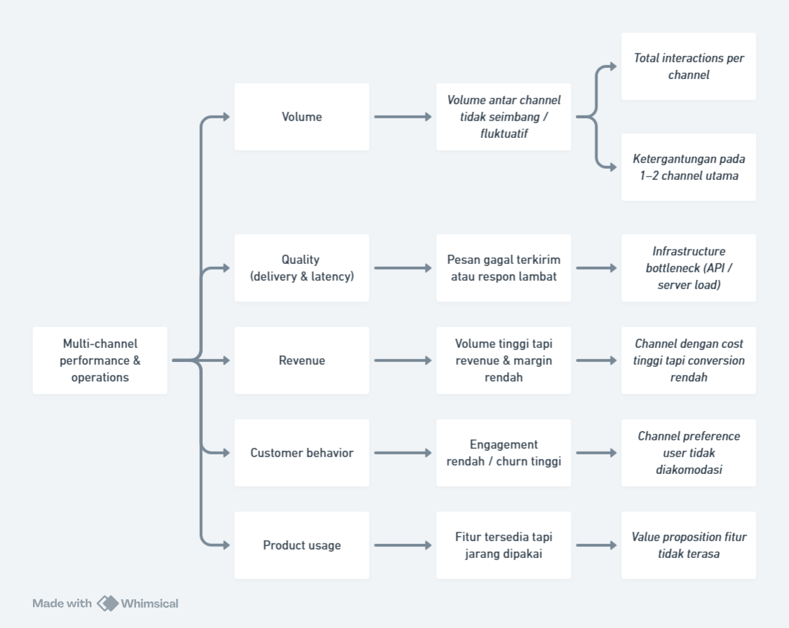
Root Cause Analysis
“The data shown has been adjusted for educational purposes and does not reflect the company’s actual business conditions.”

Slide 7
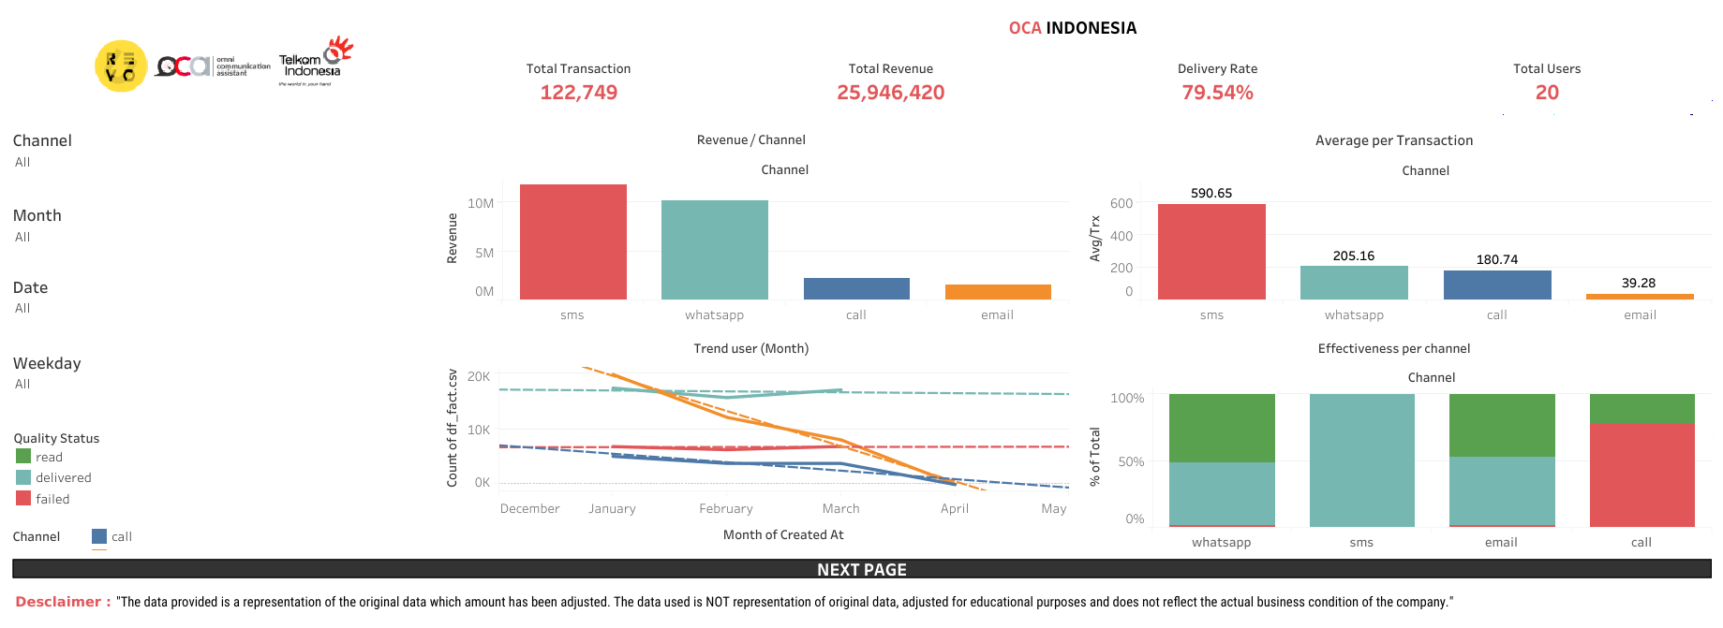
Dashboard Layout
“The data shown has been adjusted for educational purposes and does not reflect the company’s actual business conditions.”

Slide 8
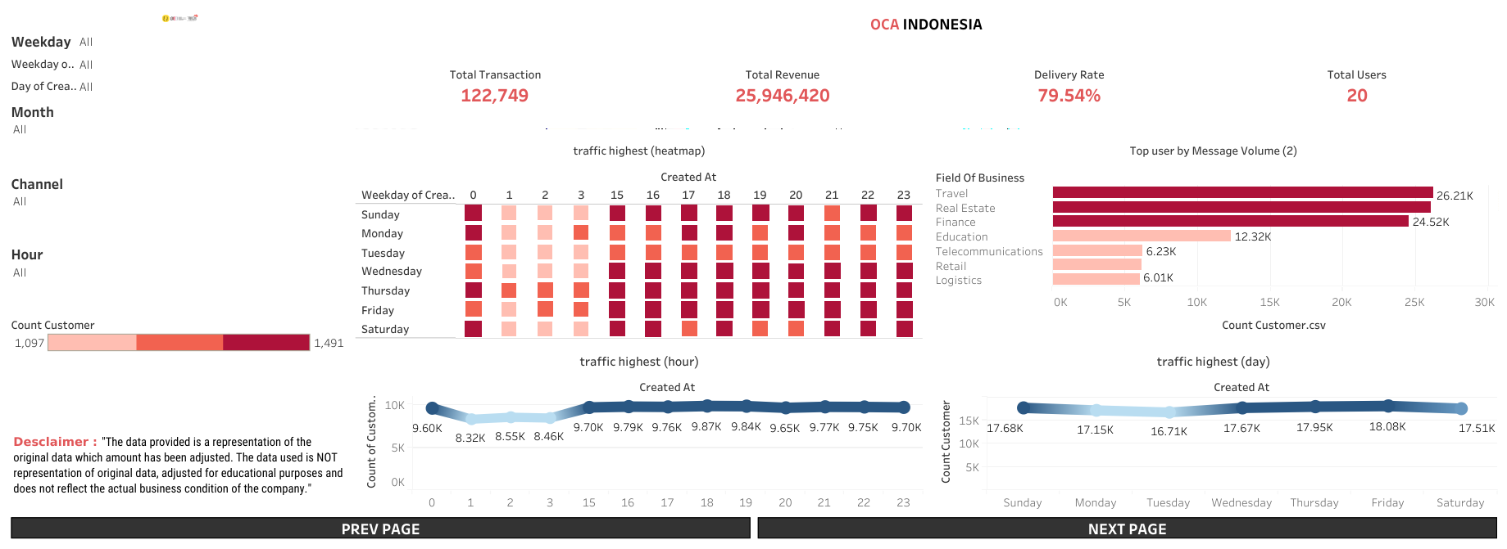
Dashboard Layout
“The data shown has been adjusted for educational purposes and does not reflect the company’s actual business conditions.”

Slide 9
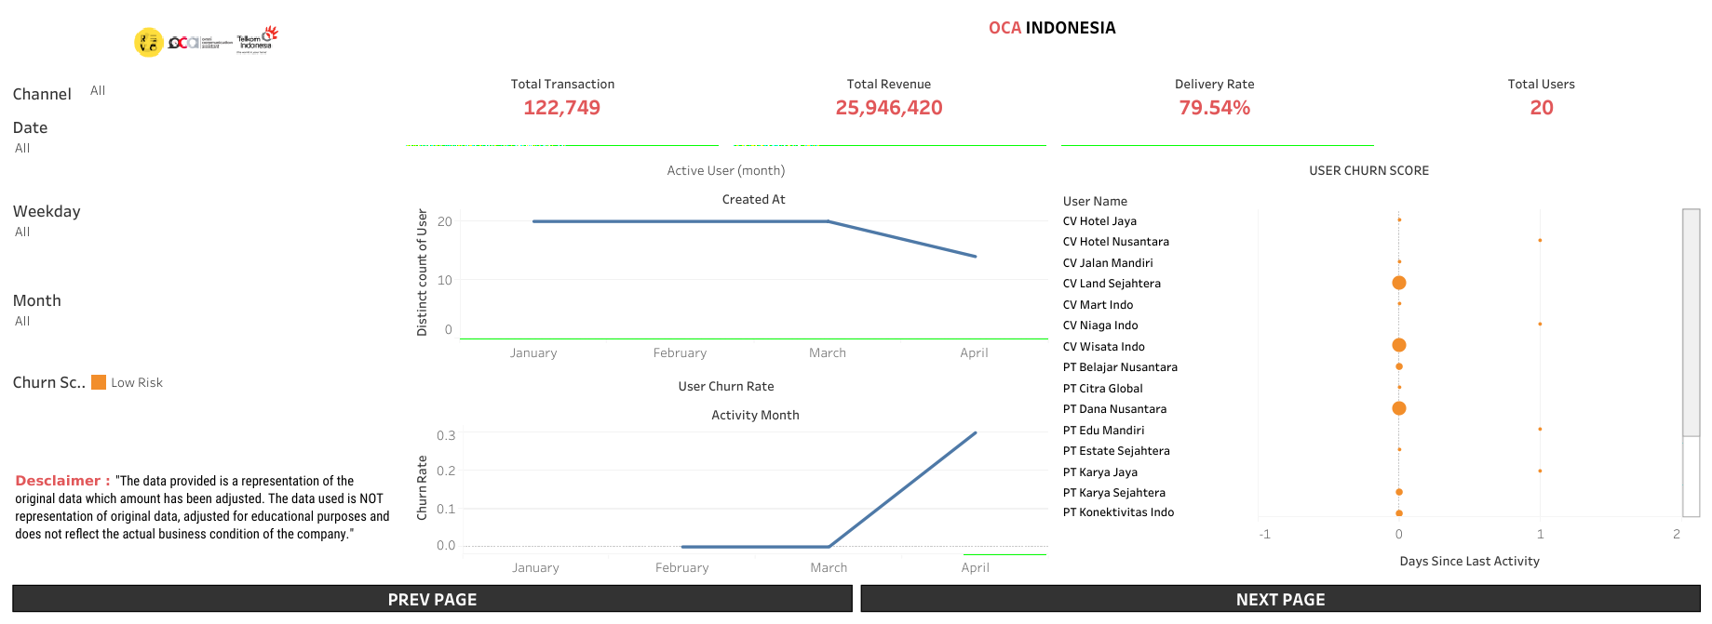
Dashboard Layout
“The data shown has been adjusted for educational purposes and does not reflect the company’s actual business conditions.”

Slide 10
02
Analyst
Tools & Methods - Python & Tableau
“The data shown has been adjusted for educational purposes and does not reflect the company’s actual business conditions.”

Slide 11

WhatsApp drives volume, SMS drives revenue, enabling a balanced omnichannel strategy.

Slide 12
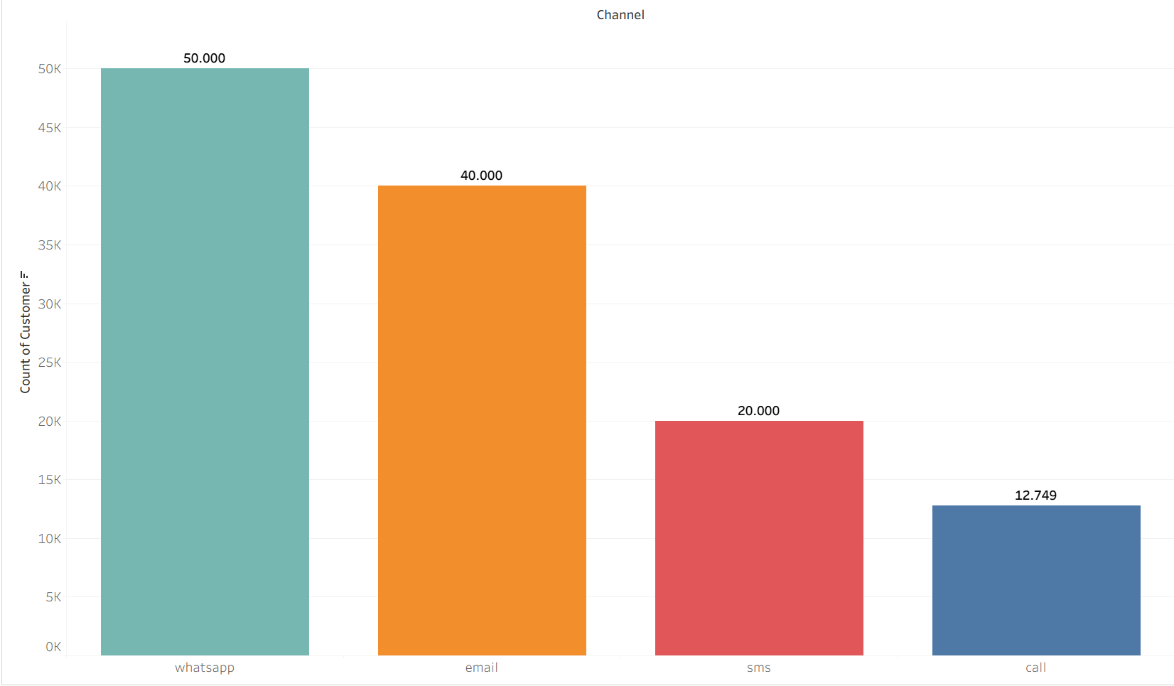
Volume Transaction
Total Channel Whatsapp 50.000 Transaction
Total Channel Email 40.000 Transaction
Total Channel SMS 20.000 Transaction
Total Channel Call 12.749 Transaction
Active Users: 20 Companies (100% Multi-channel).
WhatsApp dominates transaction volume, while all active companies consistently use multiple channels, indicating strong demand for omnichannel communication.
Total Volume 122749
“The data shown has been adjusted for educational purposes and does not reflect the company’s actual business conditions.”

Slide 13
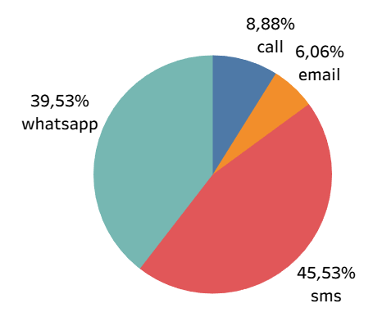
Revenue
Revenue Concentration Risk, >85% of revenue comes from SMS + WhatsApp.
SMS is Revenue King (Unexpected, but facts)
WhatsApp is High Volume but Mid Revenue
Email is Low Revenue Channel
Call is Niche Channel (Low Volume but Revenue oke)
Total All Revenue Rp. 25.946.420.
Total All Revenue
Rp. 25.946.420
“The data shown has been adjusted for educational purposes and does not reflect the company’s actual business conditions.”

Slide 14
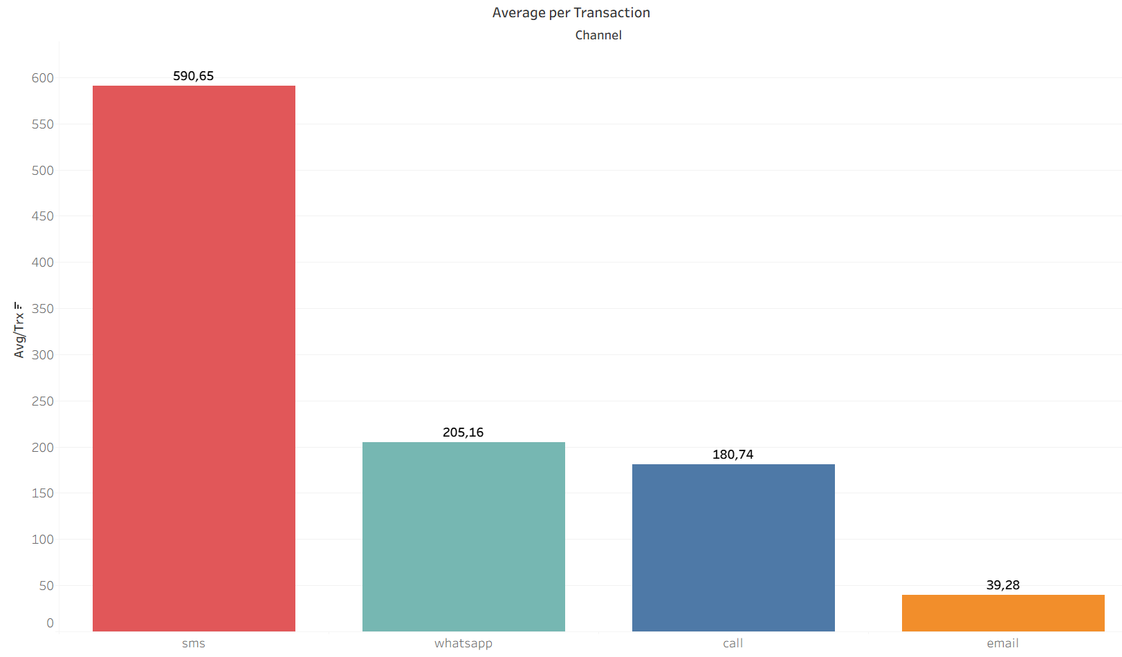
Average Per Transaction
SMS delivers the highest value per transaction, while WhatsApp drives volume with monetization potential. Email is a low-cost support channel, and Call serves high-touch use cases.
SMS is a premium channel. Although the volume is not the largest, each transaction 2.5x of WhatsApp & 12x of email.
WhatsApp is a massive volume driver, but pricing/value per transaction is still moderate.
Email is a cheap channel. It's suitable for large scale, but it contributes almost nothing to revenue.
Calls are relatively expensive to operate. This channel is for specific cases, not mass usage.
“The data shown has been adjusted for educational purposes and does not reflect the company’s actual business conditions.”

Slide 15

SMS for critical reliability, optimize WhatsApp and Email, limit Calls.

Slide 16
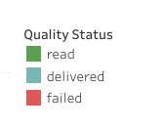
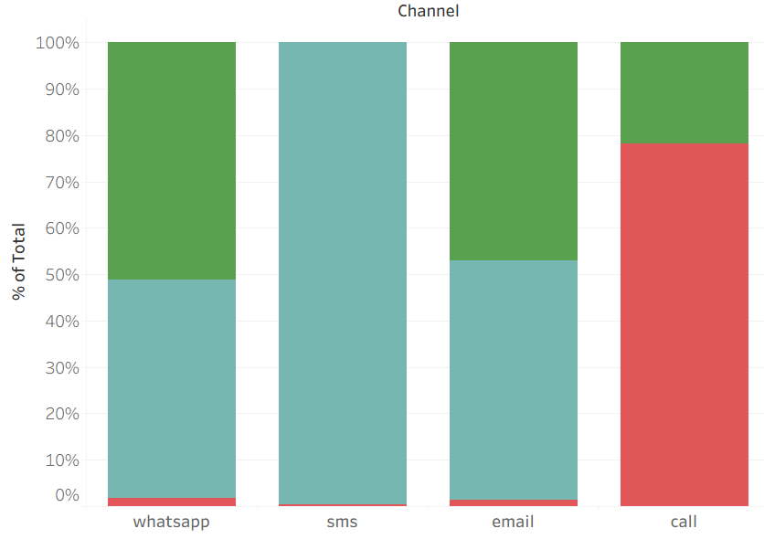
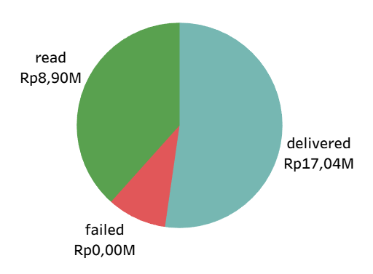
Quality of Service
SMS Is the Most Reliable and Effective Channel.
WhatsApp Performs Well but Suffers from Latency Issues.
Email Is Moderately Effective with Higher Pending Risk.
Call Channel Is Highly Ineffective Due to User Behavior
SMS is the most reliable channel, WhatsApp and Email show delivery delays, while Call is highly ineffective due to user non-response rather than technical failure.
“The data shown has been adjusted for educational purposes and does not reflect the company’s actual business conditions.”

Slide 17
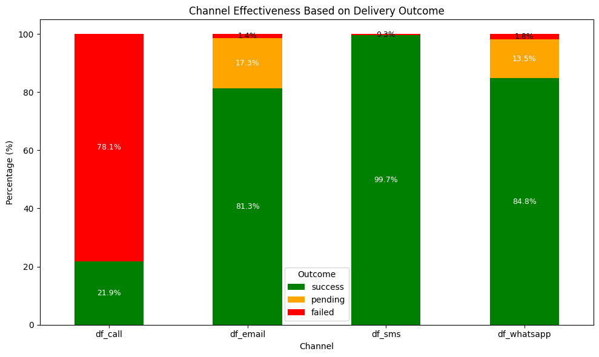
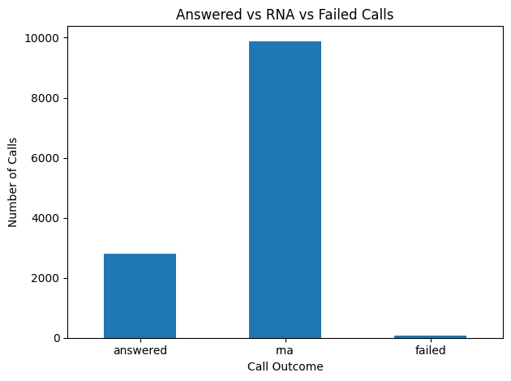
Quality of Service
Overall Delivery Effectiveness Is Strong, but Delays Remain a Concern
SMS is the most reliable channel. There are almost zero issues, making it suitable for critical communication.
The main problem with Whatsatpp & Email is not that it fails, but that it has a high pending rate.
Calls are not scalable and highly inefficient. The majority of calls are not connected, not due to technical issues, but rather user behavior (RNA).
“The data shown has been adjusted for educational purposes and does not reflect the company’s actual business conditions.”

Slide 18

Engagement stable, volume concentrated, email declining, WhatsApp drives upsell opportunities.

Slide 19
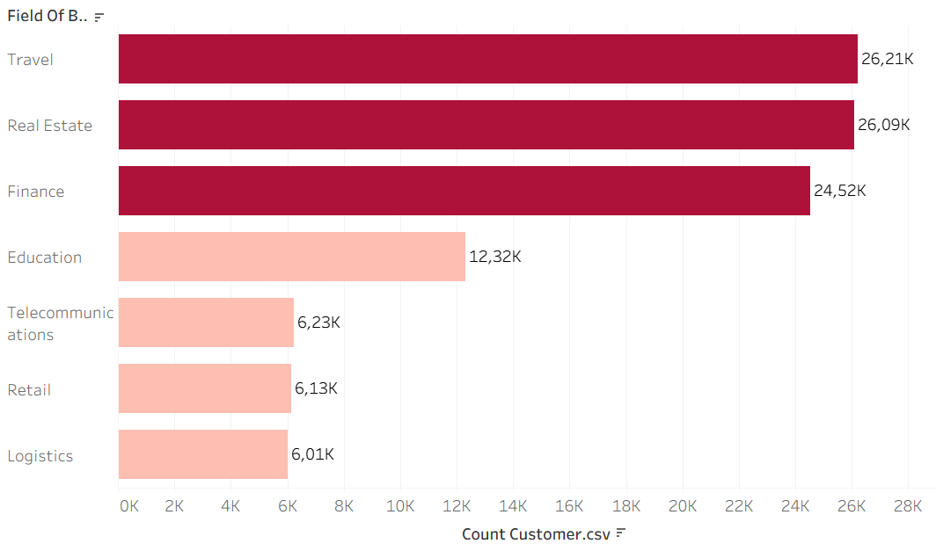
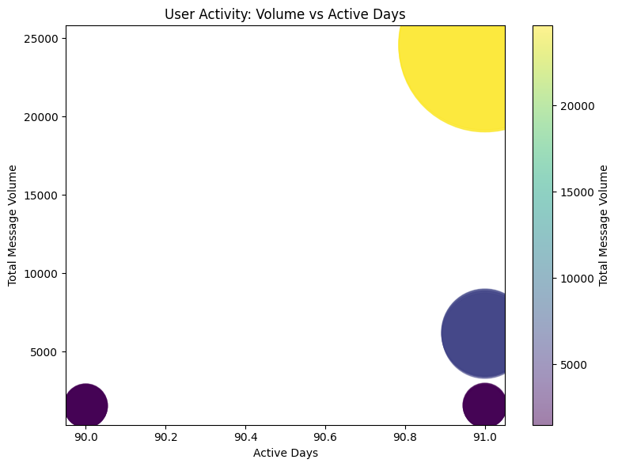
Top Users
Volume & Active Days
High Activity Does Not Always Mean High Volume.
Extreme Volume Concentration Among a Few Key Clients.
Industry Pattern: Volume-Driven vs Usage-Driven
Long-Tenured Clients Are Not Always Top Contributors
Top Users Are Very Active, but Volume Is Highly Concentrated 3 top users (Travel, Finance, Real Estate) around 24.5K
While most clients are consistently active, message volume is highly concentrated among a few key users, indicating dependency risk and strong upselling potential among highly engaged but low-volume clients.
“The data shown has been adjusted for educational purposes and does not reflect the company’s actual business conditions.”

Slide 20
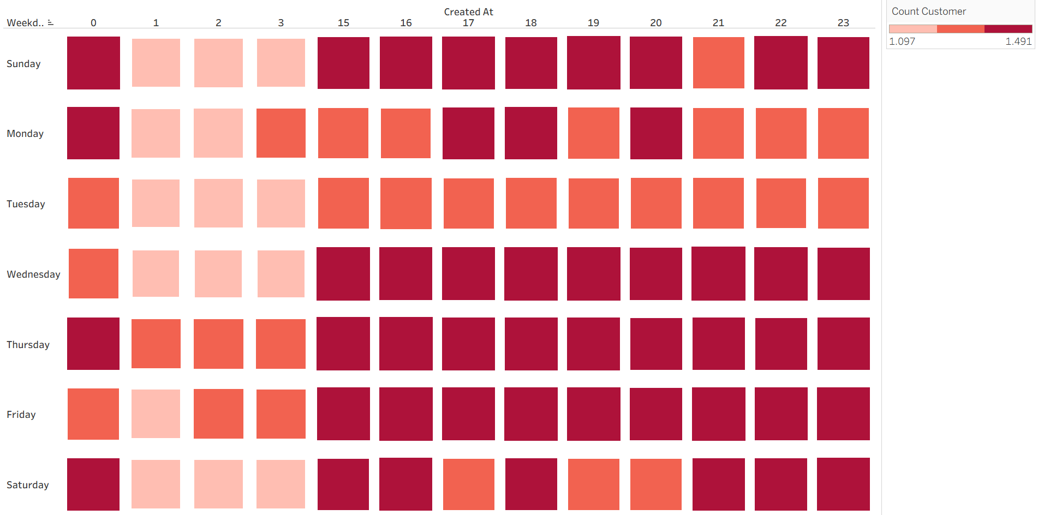
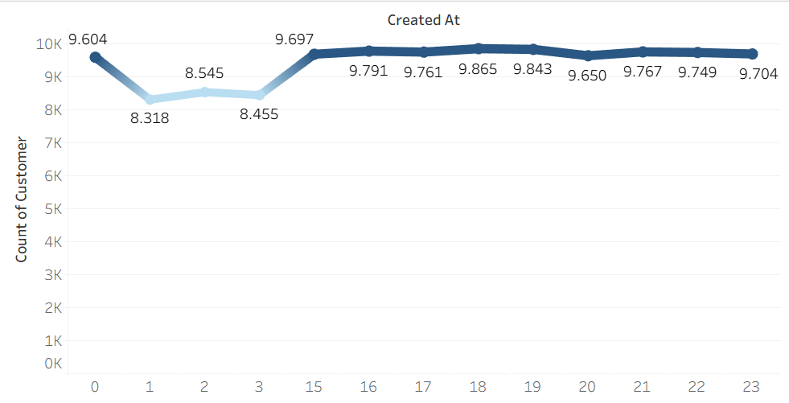
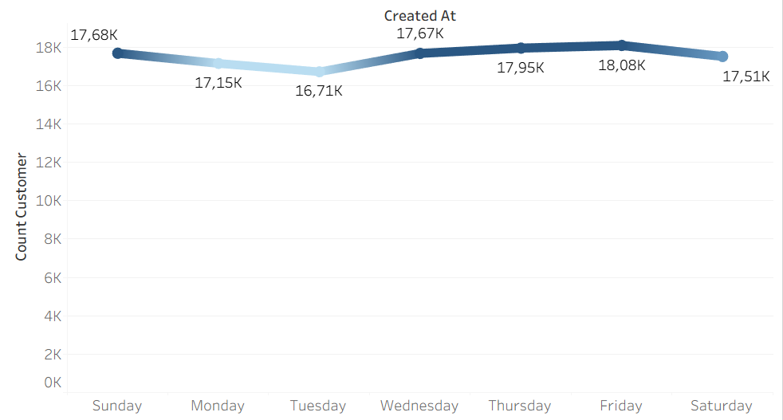
Traffic Users
Users are most responsive in the evening window, making it the optimal time for high-impact blast messages.
Consistent Engagement Throughout the Week.
Low Engagement During Early Morning Hours
User engagement peaks in the evening (15.00–23.00) and remains stable throughout the week, with the highest activity on Wednesday - Fridays, making evenings on weekdays the optimal window for blast messaging.
“The data shown has been adjusted for educational purposes and does not reflect the company’s actual business conditions.”

Slide 21
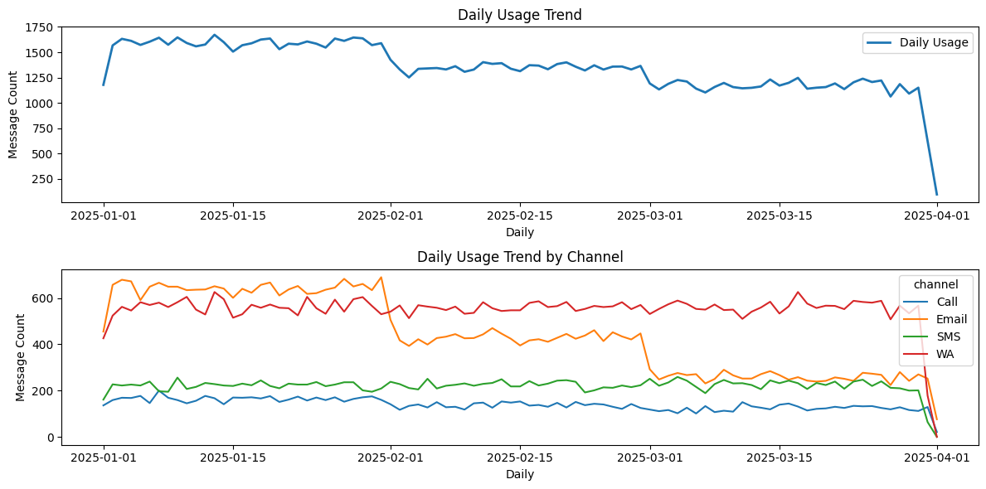
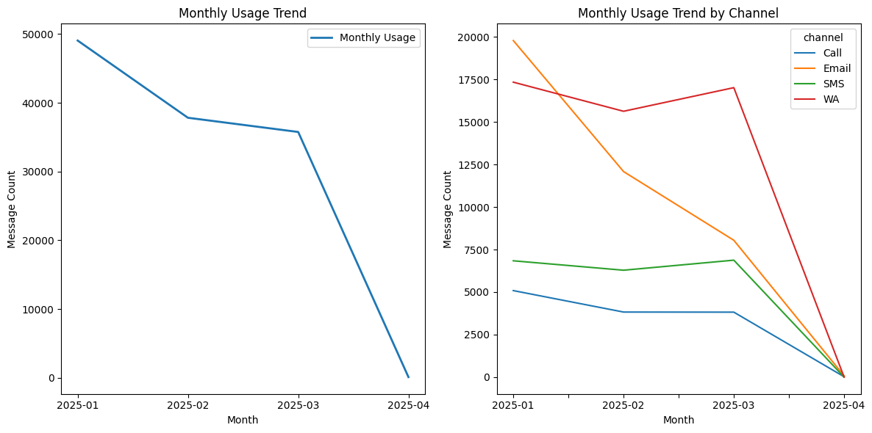
Trend Users
Daily Usage
Monthly Usage
The overall traffic decline is primarily driven by the decrease in Email usage, while the shift in user behavior toward WhatsApp highlights churn risk among Email-dependent clients and revenue opportunities through WhatsApp-focused engagement.
“The data shown has been adjusted for educational purposes and does not reflect the company’s actual business conditions.”

Slide 22
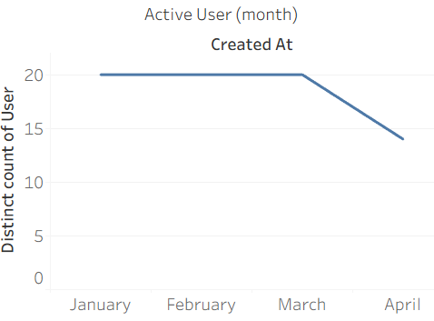
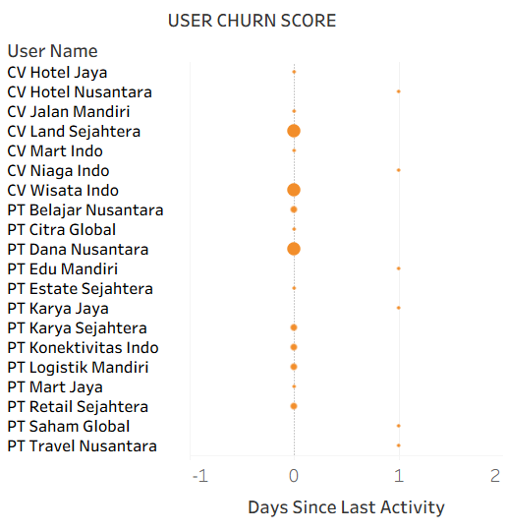
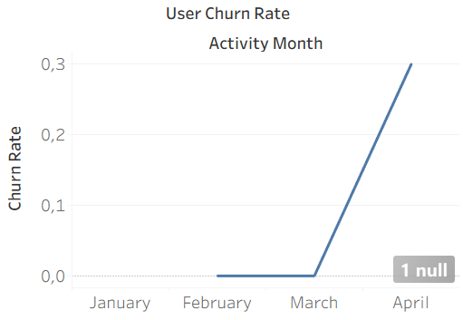
Customer Behavior
Top Users
Relatively Low Churn Risk for High-Volume & High-Engagement Users
Early Warning: Usage & Revenue Drop Begins to Appear
Upsell Opportunity pada High-Active, Low-Volume Users
Top users show strong engagement and low churn risk, but volume is highly concentrated among a few key accounts, highlighting dependency risk and significant upsell potential among consistently active yet low-volume clients.
“The data shown has been adjusted for educational purposes and does not reflect the company’s actual business conditions.”

Slide 23
Insight Summary
WhatsApp drives volume, SMS drives revenue, enabling a balanced omnichannel strategy.
SMS for critical reliability, optimize WhatsApp and Email, limit Calls.
Engagement stable, volume concentrated, email declining, WhatsApp drives upsell opportunities.
“The data shown has been adjusted for educational purposes and does not reflect the company’s actual business conditions.”

Slide 24



Recommendations
Reduce Dependency Risk through Volume Diversification
Action: Encourage increased volume from existing active but low-volume clients through bundling packages and usage incentives.
INCREASE REVENUE
RATE REVENUE
Rp. 1.667.700
6.91%
“The data shown has been adjusted for educational purposes and does not reflect the company’s actual business conditions.”

Slide 25

Recommendations
Shift Revenue Growth to WhatsApp-Centric Strategy
Action: Focus on WhatsApp as the primary channel for upsells, automation, and value-added services.
GROWTH REVENUE
Whatsapp
55.2%
Email
-5%
SMS
-5%
CALL
-5%
“The data shown has been adjusted for educational purposes and does not reflect the company’s actual business conditions.”

Slide 26
Recommendations
Protect SMS as Critical Revenue Backbone
Action: Maintain the quality, pricing power, and positioning of SMS as a critical channel, not a mass blast.
INCREASE REVENUE
RATE REVENUE
Rp. 307.138
2.6%
“The data shown has been adjusted for educational purposes and does not reflect the company’s actual business conditions.”

Slide 27


Thanks!
Let’s stay in touch !
mikhaelput@gmail.com
Code Python
Linkedin

Slide 28
Appendix.

Slide 29

Video
Presentation

Slide 30


